Slide 1
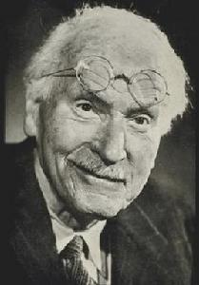
Carl Jung
翻译的标准：忠实、通顺、简洁
Carl Jung (1875–1961) was a Swiss psychiatrist who had a lasting influence on psychology and society. He studied medicine at the University of Basel from 1894 to 1900, specialising in psychiatric medicine.
卡尔∙荣格（1875-1961）是瑞士精神病学家，他对心理学以及社会有着不可磨灭的影响。1894至1900年间，他在巴塞尔大学学医，专攻精神病治疗学。

Slide 2
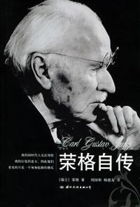
Jung developed ideas about personality types which still interest and influence people today. He identified two personality types which he called introverts and extroverts. According to Jung, extroverts find meaning outside themselves, in the surrounding world. However, introverts are introspective. They look into themselves and find meaning in themselves.
荣格提出了关于性格类型的观点，至今人们仍对他的观点颇有兴趣并深受影响。他识别了两种性格类型，即他所称的内向型和外向型。根据他的观点，外向型的人常从自身的外部，即周围环境，寻求意义。而内向型的人则经常内省，他们窥视自身，从自身内部寻求意义。

Slide 3
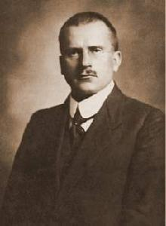
Extroverts seem to like other people. It is easy for them to form close relationships. They enjoy the excitement of crowds. They tend to be assertive, self-confident, and are often leaders in groups. They are energetic and lead busy lives.
外向的人喜欢与人交往，容易与人建立亲密关系。他们喜欢群体的热烈气氛，经常表现得坚定、自信，通常是团队的领导者。他们精力旺盛、生活忙碌。

Slide 4
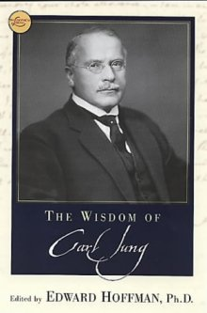
In general, they are talkative, adventurous and sociable. Introverts, on the other hand, feel comfortable alone. They avoid large crowds. They are relaxed, thoughtful and reflect before they act. They are often quiet, cautious and have good powers of concentration. They often have creative ideas.
总体而言，外向型的人健谈、冒险、友善。内向型的人则恰恰相反，他们避开人多的环境，喜欢独处。他们精神放松、思虑周全、三思而行，表现得安静、谨慎，且专注力强。这种人的想法通常具有创造性。

Slide 5
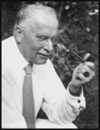
Jung’s influence on our society and culture has been enormous. Two well-known tests (Myers-Briggs and David Keirsey) are based on his theory of personality types. His ideas have influenced writers as well as film-makers like Fellini and Kubrick. Jung’s ideas have even influenced video games and rock music groups. There is still great interest in his theories on the interpretations of dreams.
荣格对社会和文化的影响巨大。两种著名的测试（迈尔斯-布里格斯测试和大卫-凯尔西测试）就是基于他的性格类型理论的。他的思想还影响了作家和电影制片人，如费里尼（Fellini）和库布里克（Kubrick），甚至对电游和摇滚乐也产生了影响。人们对他关于释梦的理论也饶有兴趣。

