Slide 1


1.2 Measuring Personality
先锋英语
电子教案

Slide 2
LISTENING AND SPEAKING
How useful do you think the following are for judging a person’s character?
1
personality tests handwriting analysis
star signs / horoscopes interviews
Have you ever done a personality test? If so, why?
2

Slide 3

3a
Listen to an interview with Dr Frank Partridge, an expert in psychometrics (the measurement of intelligence and personal qualities). Tick (✓) the topics covered in the interview.
2.4
1 things that psychometric tests measure
✓
2 the first tests
✓
3 problems with personality tests
4 the Myers-Briggs test
✓
5 the future of personality tests
Key
Clear

Slide 4
3b
Listen again and complete the questions that the interviewer asks.
1 What exactly _____ psychometrics _____ ?
does mean
2 How _____ psychometric testing _____ ?
did start
3 _____ useful _____ the tests?
How are
4 _____ they reliable?
Are
5 What _____ personality tests _____ you about a person?
can tell
6 _____ you _____ any of these tests yourself?
Have taken
7 What _____ you ________ on at the moment?
are working
Key
Clear

Slide 5
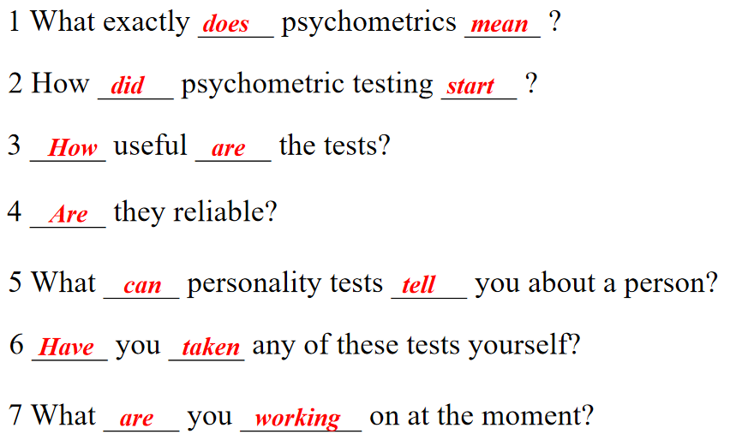
GRAMMAR: question forms
Look at the questions you completed in Exercise 3b. Which tense is used in each question?
4
present simple
past simple
present simple
present simple
present simple
present perfect
present continuous

Slide 6
Are these statements about question formation true or false?
5
T
1 In questions with the verb to be, we put the verb before the subject.
F
2 In present simple questions (except with to be), we use the auxiliary verb do / does.
F
3 In past simple questions, we use the auxiliary verb has / have.
F
4 In present continuous questions, we put do / does before the subject.
T
5 In present perfect questions, we put has / have before the subject.
Key
Clear

Slide 7
6
Look at these sentences and answer the questions.
a) Who designed the Stanford-Binet test?
— Alfred Binet designed it.
b) What did Alfred Binet design?
— Alfred Binet designed the first usable intelligence test.
a
1. In which question is the wh- word the subject? This is a subject question.
b
2. In which question is the wh- word the object? This is an object question.
3. In which type of question do we form the question with do / does?
Object questions (for example, sentence b). Do / does is used here in the past simple did because this is a past simple question).
Key
Clear

Slide 8
7a
Put the words in the right order to make questions from a psychometric test.
1. do ever you get worried ?
Do you ever get worried?
2. you are a confident person ?
Are you a confident person?
3. you do make easily friends ?
Do you make friends easily?
4 happy were you were when you child a ?
Were you happy when you were a child?
5. friends did many at you your have first school ?
Did you have many friends at your first school?
6. in your life influenced most what you has ?
What has influenced you most in your life?
7. test you a ever have personality taken ?
Have you ever taken a personality test?
8. succeeding in aims achieving your you are ?
Are you succeeding in achieving your aims?
Key
Clear

Slide 9
7b
Work with a partner to ask and answer the questions.

Slide 10
SPEAKING
Work with a partner to complete a text about Sigmund Freud. Take turns to ask and answer questions. Prepare your questions first.
8
page 158
Student A: turn to .
page 160
Student B: turn to .
a: Who was born on 6th May 1856?
b: Sigmund Freud.

Slide 11
READING
9a
Read the introduction to the article. Who or what are the following?
1. Hideo Nakata
a Japanese film director
2. Ring and Ring 2
4. Suzuki Koji
the films that made him internationally famous
3. Reiko Asakawa
the main character (a reporter) in Ring
the man who wrote the book that Ring was based on.
Note: in Japanese, it is normal for the family name to precede the first name, i.e. in the text it says Koji Suzuki, in which Koji is his first name.

Slide 12


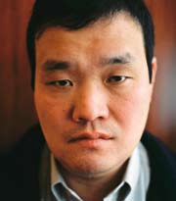
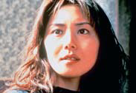
This month we talk to Hideo Nakata, the Japanese film-maker, who became
internationally famous when he directed two films, Ring and Ring 2 (both 1998).
Both films were the most successful horror films ever produced in Japan. Part of the reason for this is that the stories are very original and
creative.
▲ Hideo Nakata
▲ Nanako Matsushima as Reiko Asakawa in Ring.

Slide 13
The Ring films are about a videotape that kills everyone exactly one week after they view it. In the first film a reporter, Reiko Asakawa, tries to solve the mystery, but she also has only one week left to live after watching the film.
Ring was a huge success because it showed the psychology and personalities of its main characters and it created an atmosphere
of tension and anticipation.
Asakawa’s character transformation is astonishing — from a curious reporter investigating a story to a human being living in terror as she approaches almost certain death.
Nakata wants to create dramas with a touch of humanity. For him, films should be about the essential human emotions such as
tears, laughter and fear.

Slide 14
The film is based on a book written by Koji Suzuki. In the book, the main character is male, but in the film she is female. Nakata likes to make movies that focus on female personalities.
1Why did you become a director?
I began as a real movie fan and I just wanted to go on the other side of the screen. I became an assistant director at a film studio and then of course I gradually wanted to become a film director.
2_______________
Ring 2 because I wanted to see it with a real audience.
3_______________
Oh … Walked out? No, I usually watch everything until the end.
4________________
Very difficult. Can I name a Japanese director? It’s Makino Masahiro. He made a lot of Yakuza movies.

Slide 15
5________________
Hmm. No comment.
6________________
I can’t read them all, but for Japanese movies, I’ll read as many as I possibly can. But for American movies, like, I have to say reviews don’t matter that much — especially for horror movies.
It’s because the majority of my audience don’t read reviews.
7________________
I try my best in terms of my professional life. I always try to do
my best so I don’t have to regret. So I have no regrets.
8________________
Try to contact all my old friends.

Slide 16
Read the rest of the . Fill the gaps 1–8 with these questions.
9b
interview
1 What’s your biggest regret?
2 What was the last movie you walked out of?
3 Why did you become a director?
4 There are five minutes left till the end of the world — what do
you do?
5 How seriously do you take reviews?
6 What was the last movie that you paid to see?
7 And which film-maker do you consider the most overrated?
8 What film-maker do you consider the most underrated?

Slide 17
The film is based on a book written by Koji Suzuki. In the book, the main character is male, but in the film she is female. Nakata likes to make movies that focus on female personalities.
1Why did you become a director?
I began as a real movie fan and I just wanted to go on the other side of the screen. I became an assistant director at a film studio and then of course I gradually wanted to become a film director.
2_______________
Ring 2 because I wanted to see it with a real audience.
3_______________
Oh … Walked out? No, I usually watch everything until the end.
4________________
Very difficult. Can I name a Japanese director? It’s Makino Masahiro. He made a lot of Yakuza movies.
6 What was the last movie that you paid to see?
2 What was the last movie you walked out of?
8 What film-maker do you consider the most underrated?

Slide 18
5________________
Hmm. No comment.
6________________
I can’t read them all, but for Japanese movies, I’ll read as many as I possibly can. But for American movies, like, I have to say reviews don’t matter that much — especially for horror movies.
It’s because the majority of my audience don’t read reviews.
7________________
I try my best in terms of my professional life. I always try to do
my best so I don’t have to regret. So I have no regrets.
8________________
Try to contact all my old friends.
7 And which film-maker do you consider the most overrated?
5 How seriously do you take reviews?
1 What’s your biggest regret?
4 There are five minutes left till the end of the world — what do you do?

Slide 19
9c
Why do you think he changed the main character from male to female?
WRITING
10
Imagine you are going to meet a famous person, dead or alive (e.g. a famous leader in history, a film star, a pop star, a character in a book). Write down five questions you would like to ask them. Compare your questions with a partner.

Slide 20
汉语译文
Director of the month: Hideo Nakata
本月导演——中田秀夫
This month we talk to Hideo Nakata, the Japanese film-maker, who became internationally famous when he directed two films, Ring and Ring 2 (both 1998). Both films were the most successful horror films ever produced in Japan. Part of the reason for this is that the stories are very original and creative.
本月与我们对话的是日本制片人中田秀夫。中田先生于
1998年导演了《午夜凶铃》和《午夜凶铃2》，这两部影片使他获得了国际声誉。两部影片之所以成为最成功的日产恐怖电影，部分原因是这两部影片的故事情节具有非常强的原创性和创造性。

Slide 21
The Ring films are about a videotape that kills everyone exactly one week after they view it. In the first film a reporter, Reiko Asakawa, tries to solve the mystery, but she also has only one week left to live after watching the film.
《午夜凶铃》系列电影讲的是一本录影带。每一个观看过这本录影带的人都会在刚好一周后死亡。在《午夜凶铃》的第一部中，记者武藤兰（Reiko Asakawa）竭力解开这一谜团。然而，在观看了该录影带后，她的生命也仅剩一周了。

Slide 22
Ring was a huge success because it showed the psychology and personalities of its main characters and it created an atmosphere of tension and anticipation. Asakawa’s character transformation is astonishing — from a curious reporter investigating a story to a human being living in terror as she approaches almost certain death.
《午夜凶铃》的巨大成功源于它展现了其各个主要人物的心理状态和性格特征，创造了一种紧张和预感不测的气氛。武藤兰最初是一名充满好奇的、调查故事的记者，在死亡临近的瞬间转变成生活在恐怖之中的人，这种角色变化令人震惊不已。

Slide 23
Nakata wants to create dramas with a touch of humanity. For him, films should be about the essential human emotions such as tears, laughter and fear.
中田秀夫想创作一些展现人性的影视剧。在他看来，电影应该表现诸如泪水、欢笑、恐惧等基本的人类情感。
The film is based on a book written by Koji Suzuki. In the book, the main character is male, but in the film she is female. Nakata likes to make movies that focus on female personalities.
该电影基于铃木光司的小说。但小说中的主角是一名男子，而在电影中却是一位女性。中田喜欢拍摄以女性为主题的电影。

