Slide 1
Introduction: What’s new?

Slide 2
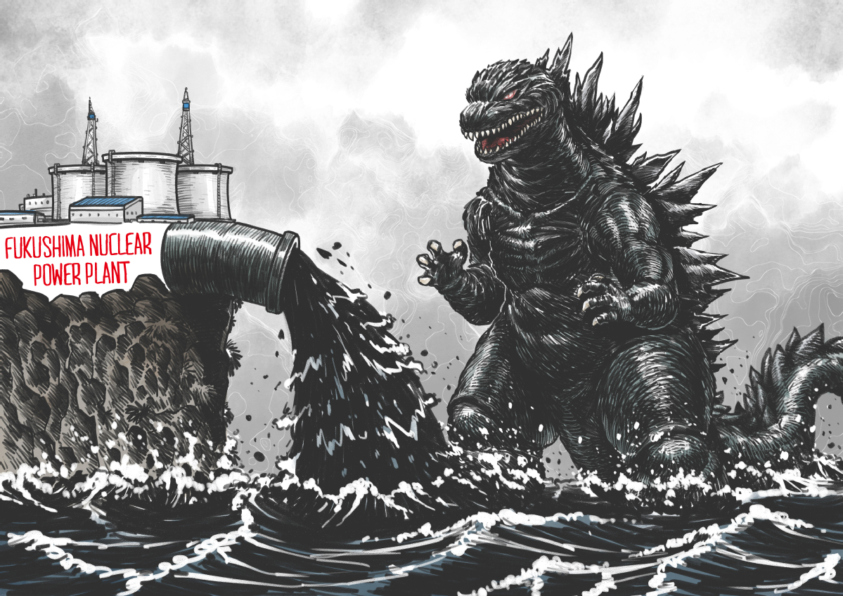
Japan plan to dump nuclear wastewater into Pacific sparks anger
Godzilla
nuclear wastewater

Slide 3
5.2 Ways of Advertising
Unit 5 Advertising
Hanson

Slide 4
Aims and Demand
We are to
learn (more) about different methods for advertising;
practise listening to a conversation and reading a text to extract specific information and language items;
extend our vocabulary in the context of ways of advertising;
revise the second conditional for unreal situations in the present or future

Slide 5
Reading

Slide 6
1. Work with a partner to discuss the following.
What are the most common ways of advertising products and services today?
What ways of advertising do you think people used before paper was invented?

Slide 7
2a Read the article and underline the different ways of advertising mentioned.
word of mouth;
inscriptions on walls;
(papyrus) posters;
wall or rock painting;
handbills;
advertisements in weekly newspapers;
classified adverts;
mail order catalogues;
product placement;
TV commercials;
endorsements

Slide 8
2b Answer the questions about the first three paragraphs of the article.
1) What sort of things were advertised in ancient times?
political campaigns; household goods for sale; things people had lost or found; goods
2) What effect did printing have on advertising?
It increased the forms of advertising.

Slide 9
3) Which statements are true about the1960s?
People used more imagination when making advertisements.
Advertisements gave much more information.
Advertisements focused more on the special features of products.
True
False (they gave more specific information)
True

Slide 10
4) What is a USP? Why is it important for a new product to have a USP?
USP = Unique Selling Point (the qualities that make a product different from other products)

Slide 11
2c Complete the summary of paragraphs 4–7 of the article with no more than three words in each gap.
What sort of things were advertised in ancient times? Three ways of advertising nowadays are product placement, TV commercials and using famous personalities to ¹ _______________________________ In the film, Minority Report, two ²___________Nokia and Bulgari, used product placement to advertise their brands. During the Superbowl game in the US, advertisers pay $2.5 million for ³ _____________________.
Endorsements are also a good way of advertising because they usually ⁴____________but they can be expensive.
endorse/promote goods/products/sales
companies
30-second TV commercial
increase sales

Slide 12
VOCABULARY: advertising methods
3 Find words and phrases in the text that mean the following.
1 passing messages from one person to another orally
word-of-mouth
2 a large notice or picture to advertise something
poster
3 a colourful image on stone
wall or rock painting (Note: inscriptions on walls refer to writing not images.)
4 small notices and advertisements
handbills

Slide 13
5 a small advert in a newspaper to buy or sell something
classified adverts
6 buying goods from a company that sends them by post
mail order (Note: the catalogue is the book with descriptions of the products.)
7 advertising a product by putting it in a film or a television programme
product placement
8 use of a product by a well-known person who says they like it
endorsement (Note: the noun is needed here.)

Slide 14
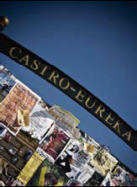
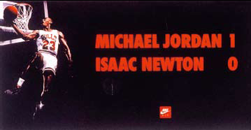
ADVERTISING
Then AND Now

Slide 15
[1] Most advertising in ancient times was word-of-mouth, that is, people liked something and told others about it. But even then, people advertised by putting inscriptions on walls, for example to display political slogans and to offer household goods for sale. Also, in Rome and Greece, in ancient times, it was common for people to use papyrus, a kind of paper, to advertise things they had lost or found. Papyrus was also used for posters to advertise political campaigns. Many traces of these advertisements have been found in the ruins of Pompeii, a city destroyed by a volcano which erupted in 79 AD. The tradition of wall or rock painting as a way of advertising goods is even more ancient and examples can still be found in parts of Asia, Africa and South America.

Slide 16
[2] Printing developed in the 15th and 16th centuries, and this increased the forms of advertising. Handbills — small printed notices and advertisements — became common. Then, by the 17th century, advertisements started appearing in weekly newspapers in England, including classified adverts for personal goods and services. In the 19th century mail order catalogues appeared, promoting all kinds of goods.
[3] Finally, the 1960s were a key period in the development of advertising. Advertisements became more creative and more interesting. Also, they began to draw attention to the “unique selling points”, the USPs of products. These are the qualities that make a product different from competitors’ products.

Slide 17
[4] These days, advertisers have come up with new ways of promoting their products. For example, product placement is now common. This is advertising in TV programmes or films by having a character, preferably played by a famous actor, use a particular product. For example, Tom Cruise’s character in the movie, Minority Report, had a computer with the Nokia logo on it, and his watch was clearly made by Bulgari.
[5] TV commercials are a very effective medium for advertisers, though these are very expensive. If an organisation wants to have a 30-second TV advert during the annual Superbowl game* in the United States, they have to pay about $2.5 million.

Slide 18
[6] Perhaps the most interesting development is the use of famous personalities to endorse a product. The basketball player, Michael Jordan, endorsed Nike products and wore them while playing. David Beckham, the footballer, endorsed Police sunglasses.
[7] Getting well-known personalities to endorse a product can be very expensive, but endorsements certainly increase a product’s sales, especially if the personality has a positive image in the eyes of the public.
*The Superbowl is the championship game of the National Football League (NFL), the highest level of professional American football in the United States, culminating a season that begins in the late summer of the previous calendar year. 超级杯, 美国国家美式足球联盟的年度冠军赛。

Slide 19
Listening

Slide 20
LISTENING
2.26
4a Listen to the conversation between a manufacturer and a marketing consultant. What kind of product are they talking about? Which group of consumers is it aimed at?
The product is watches; the consumer group is young people.

Slide 21
LISTENING
4b Listen again and complete the sentences.
had
1 If we _______ a bigger budget, we’d get someone well-known to endorse the product.
were
2 If I _______ you, I’d look for a cheaper way of doing it.
could
3 If you ran a series of short TV commercials, you _____ reach a younger audience ….
4 Yes, if we got the right people, it _______ be a lot cheaper than using a film star.
might
5 If you got a young director to do the films, you ________ have to pay them too much.
wouldn’t

Slide 22
GRAMMAR: second conditional
5 Look at the sentences from Exercise 4b and choose the correct answer.
In the second conditional …
1 we use the / present simple in the if-clause, and the
past simple / in the main clause.
2 we can use a modal verb, e.g. could or might, in the if-clause /
.
3 we talk about / a real situation in the present or future.
4 we can say / If I would you to give advice.
past simple
would (’d) + infinitive without to
the main clause
an unreal
If I were you
Key
Clear

Slide 23
6 Complete the sentences in the second conditional, using the verbs in brackets.
1. If I _____ the agency’s number, I ___________ them. (know, phone)
2. If we ____ the choice, we _________ on the radio.(have, advertise)
3. If you _______ in charge of the advertising campaign, what _________? (be, you do)
4. What _______ if we _______ before 9 p.m.? (happen, advertise)
5. If he ________ for a job in our agency, he probably ____________ it. (apply, not get )

Slide 24
Key to Activity 6:
1. If I knew the agency’s number, I would phone them. (know, phone)
2. If we had the choice, we would advertise on the radio.(have, advertise)
3. If you were in charge of the advertising campaign, what would you do? (be, you do)
4. What would happen if we advertised before 9 p.m.? (happen, advertise)
5. If he applied for a job in our agency, he probably would not get it. (apply, not get )

Slide 25
SPEAKING AND WRTING
7
In small groups, say which of the media in the box you would use to advertise the products and services below. You can only choose one medium for each product. Give reasons for your choices.
If I wanted to advertise an expensive ring, I’d put it on the Internet.
TV commercials
radio spots
newspapers
magazines
billboards
the Internet
leaflets
sides of buses / taxis
telephone calls

Slide 26
● an expensive ring
● financial advice
● a new range of computers
● a request for information
about a crime
● raising money for a charity
● a household item, e.g. a
carpet
● a lost wallet
● a valuable antique chair
● an unwanted new mobile phone
8
Choose one of the products / services from above and write a brief description of how you would advertise it. Include a slogan if necessary.

Slide 27
Thank you!

