Slide 1
小清新总结计划通用模板
THIS IS A ART TEMPLATE , THANK YOU WATCHING THIS ONE. THANK YOU WATCHING THIS ONE.
Notes:
更多模板请关注：https://haosc.taobao.com

Slide 2
C O N T E N T
点击此处添加标题
点击此处添加标题
0 1
0 2
您的内容打在这里，或者通过复制您的文本后，在此框中选择粘贴，并选择只保留文字。
您的内容打在这里，或者通过复制您的文本后，在此框中选择粘贴，并选择只保留文字。
点击此处添加标题
点击此处添加标题
03
0 4
您的内容打在这里，或者通过复制您的文本后，在此框中选择粘贴，并选择只保留文字。
您的内容打在这里，或者通过复制您的文本后，在此框中选择粘贴，并选择只保留文字。

Slide 3
0 1
点 击 此 处 添 加 标 题
您的内容打在这里，或者通过复制您的文本后，在此框中选择粘贴，并选择只保留文字。

Slide 4
点击此处添加标题
您的内容打在这里，或者通过复制您的文本后，在此框中选择粘贴，并选择只保留文字。在此录入上述图表的综合描述说明。
点击此处添加标题
您的内容打在这里，或者通过复制您的文本后，在此框中选择粘贴，并选择只保留文字。在此录入上述图表的综合描述说明。

Slide 5
您的内容打在这里，或者通过复制您的文本后，在此框中选择粘贴，并选择只保留文字
您的内容打在这里，或者通过复制您的文本后，在此框中选择粘贴，并选择只保留文字
您的内容打在这里，或者通过复制您的文本后，在此框中选择粘贴，并选择只保留文字

Slide 6
0 1
Just for today I will try to live through this day only and not tackle my whole life problem at once
0 2
Just for today I will try to live through this day only and not tackle my whole life problem at once
0 3
Just for today I will try to live through this day only and not tackle my whole life problem at once

Slide 7
请输入你的题目
请输入你的题目
请输入你的题目
请输入你的题目
Just for today I will try to live through this day only and not tackle my whole life problem at once. Just for today I will try to live through this day only and not tackle my whole life problem at once.
Just for today I will try to live through this day only and not tackle my whole life problem at once. Just for today I will try to live through this day only and not tackle my whole life problem at once.
Just for today I will try to live through this day only and not tackle my whole life problem at once. Just for today I will try to live through this day only and not tackle my whole life problem at once.
Just for today I will try to live through this day only and not tackle my whole life problem at once. Just for today I will try to live through this day only and not tackle my whole life problem at once.

Slide 8
0 2
点 击 此 处 添 加 标 题
您的内容打在这里，或者通过复制您的文本后，在此框中选择粘贴，并选择只保留文字。

Slide 9
此处添加标题
此处添加标题
68%
您的内容打在这里，或者通过复制您的文本后，在此框中选择粘贴，并选择只保留文字。在此录入上述图表的综合描述说明。
75%
您的内容打在这里，或者通过复制您的文本后，在此框中选择粘贴，并选择只保留文字。在此录入上述图表的综合描述说明。
此处添加标题
45%
此处添加标题
85%
您的内容打在这里，或者通过复制您的文本后，在此框中选择粘贴，并选择只保留文字。在此录入上述图表的综合描述说明。
您的内容打在这里，或者通过复制您的文本后，在此框中选择粘贴，并选择只保留文字。在此录入上述图表的综合描述说明。

Slide 10
点击此处添加标题
您的内容打在这里，或者通过复制您的文本后，在此框中选择粘贴，并选择只保留文字。在此录入上述图表的综合描述说明。
点击此处添加标题
您的内容打在这里，或者通过复制您的文本后，在此框中选择粘贴，并选择只保留文字。在此录入上述图表的综合描述说明。

Slide 11
TITLE HERE
TITLE HERE
TITLE HERE
TITLE HERE
Just for today I will try to live through this day only and not tackle my whole life
Just for today I will try to live through this day only and not tackle my whole life
Just for today I will try to live through this day only and not tackle my whole life
Just for today I will try to live through this day only and not tackle my whole life
01
02
03
04

Slide 12
0 3
点 击 此 处 添 加 标 题
您的内容打在这里，或者通过复制您的文本后，在此框中选择粘贴，并选择只保留文字。

Slide 13
1
Just for today I will exercise my soul in three ways. I will do somebody a good turn and not get found out: If anybody knows of it,
2
Just for today I will exercise my soul in three ways. I will do somebody a good turn and not get found out: If anybody knows of it,
3
Just for today I will exercise my soul in three ways. I will do somebody a good turn and not get found out: If anybody knows of it,

Slide 14
04 YOUR TITLE
03 YOUR TITLE
Click here to enter your text messages click here to enter your text messages click here to enter your text
02 YOUR TITLE
01 YOUR TITLE
Click here to enter your text messages click here to enter your text messages click here to enter your text
Click here to enter your text messages click here to enter your text messages click here to enter your text
Click here to enter your text messages click here to enter your text messages click here to enter your text

Slide 15
ADD TITLE HERE
Just for today I will try to live through this day only and not tackle my whole life once.
01
ADD TITLE HERE
02
Just for today I will try to live through this day only and not tackle my whole life once.
ADD TITLE HERE
03
Just for today I will try to live through this day only and not tackle my whole life once.

Slide 16
0 4
点 击 此 处 添 加 标 题
您的内容打在这里，或者通过复制您的文本后，在此框中选择粘贴，并选择只保留文字。

Slide 17
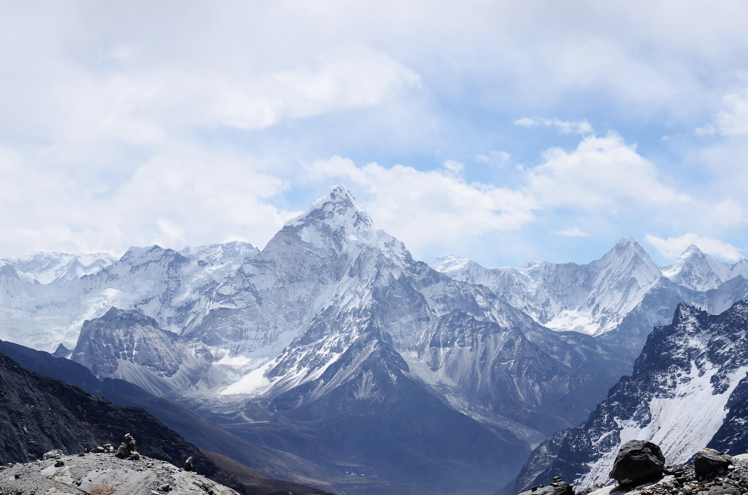
点击此处添加标题
点击此处添加标题
您的内容打在这里，或者通过复制您的文本后，在此框中选择粘贴，并选择只保留文字。
您的内容打在这里，或者通过复制您的文本后，在此框中选择粘贴，并选择只保留文字。
点击此处添加标题
点击此处添加标题
您的内容打在这里，或者通过复制您的文本后，在此框中选择粘贴，并选择只保留文字。
您的内容打在这里，或者通过复制您的文本后，在此框中选择粘贴，并选择只保留文字。

Slide 18
ADD YOUR TITLE
70%
Nothing we can do will change it. The future is before us and dynamic. Everything we do will
ADD YOUR TITLE
Nothing we can do will change it. The future is before us and dynamic. Everything we do will
90%
ADD YOUR TITLE
Nothing we can do will change it. The future is before us and dynamic. Everything we do will
50%

Slide 19
three ways. I will do somebody a good turnJust for today I will try to live through this day only and not tackle my
three ways. I will do somebody a good turnJust for today I will try to live through this day only and not tackle my
three ways. I will do somebody a good turnJust for today I will try to live through this day only and not tackle my
three ways. I will do somebody a good turnJust for today I will try to live through this day only and not tackle my
three ways. I will do somebody a good turnJust for today I will try to live through this day only and not tackle my
three ways. I will do somebody a good turnJust for today I will try to live through this day only and not tackle my

Slide 20
感 谢 您 的 观 看
THIS IS A ART TEMPLATE , THANK YOU WATCHING THIS ONE. THANK YOU WATCHING THIS ONE.

