Slide 1


Human Food
人 类 的 食 物
商务培训 | 教学辅导 | 人文自然 | 少年科普
.
Notes:
更多模板请关注：https://haosc.taobao.com

Slide 2

CONTENTS
01
教学内容与地位、作用
02
教学策略与教学建议
03
人类食物的营养成分
04
教学实践与总结
.

Slide 3


01
教学内容与地位、作用
.

Slide 4
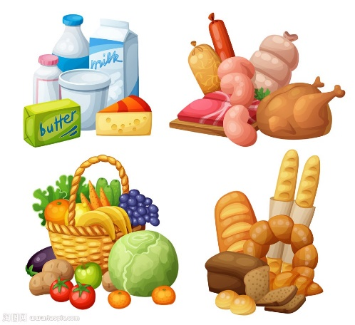
Human
Food
We’re here to connect people to higher education in the UK. We’re a people-focused business and everything we do is designed to help applicants reach their potential. It’s a great feeling.
PICTURE SHOW
PICTURE SHOW
We’re here to connect people to higher education in the UK. We’re a people-focused business and everything we do is designed to help applicants reach their potential. It’s a great feeling.
We’re here to connect people to higher education in the UK. We’re a people-focused business and everything we do is designed to help applicants reach their potential. It’s a great feeling.
.

Slide 5

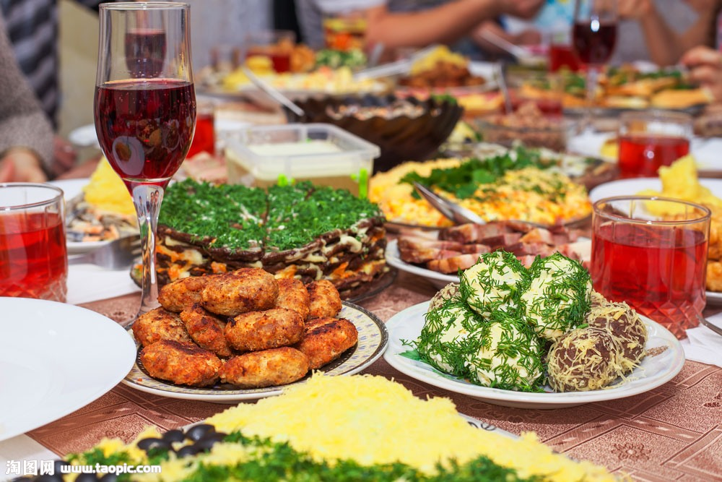
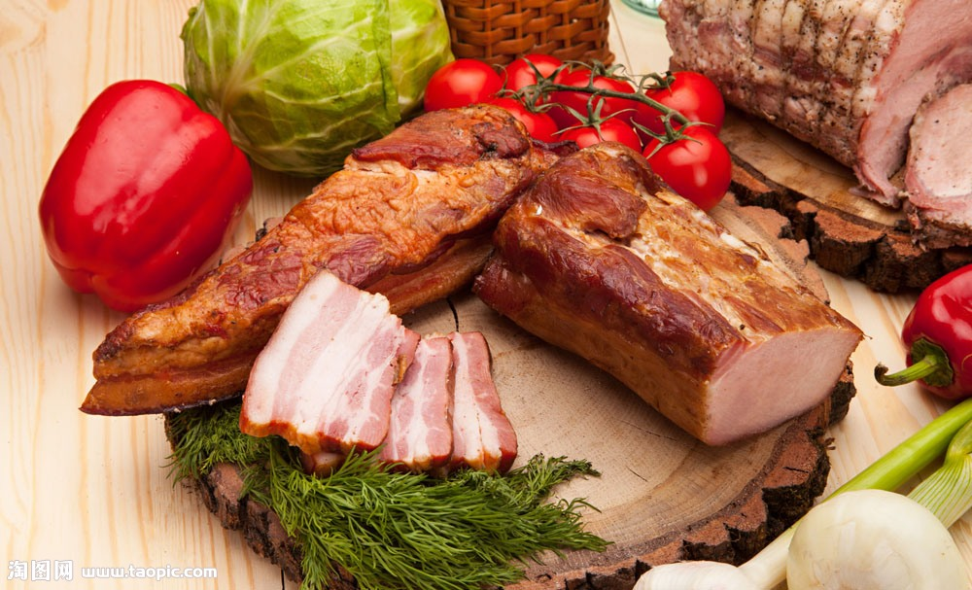
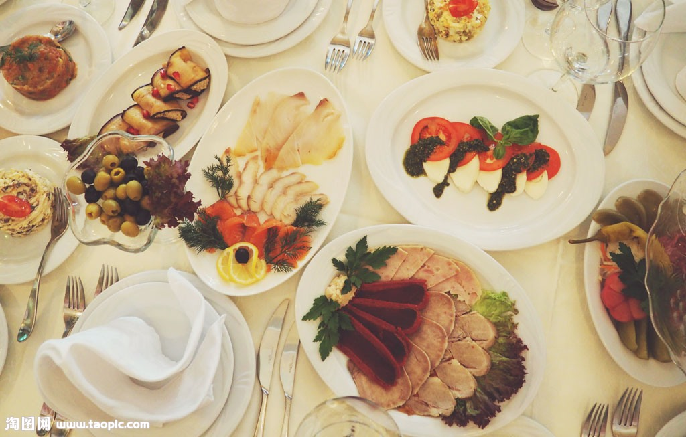
PICTURE SHOW
We’re here to connect people to higher education in the UK. We’re a people-focused business and everything we do is designed to help applicants reach their potential. It’s a great feeling.
PICTURE SHOW
We’re here to connect people to higher education in the UK. We’re a people-focused business and everything we do is designed to help applicants reach their potential. It’s a great feeling.
.

Slide 6
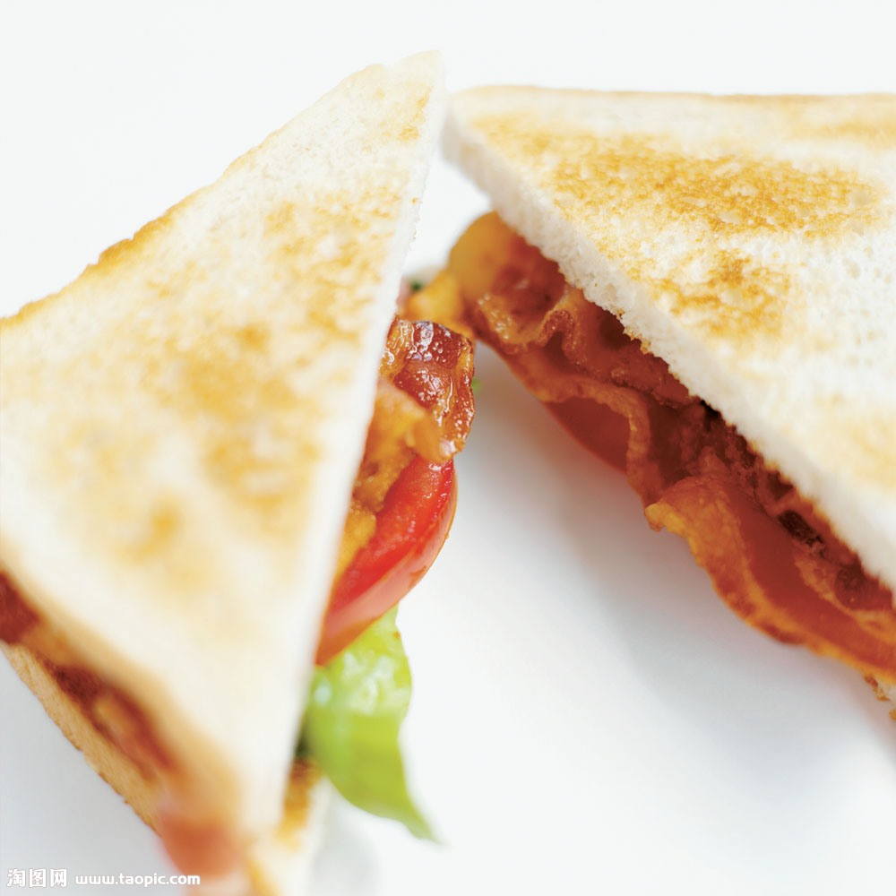
PICTURE SHOW
We’re here to connect people to higher education in the UK. We’re a people-focused business and everything we do is designed to help applicants reach their potential. It’s a great feeling.
.

Slide 7


PICTURE SHOW
We’re here to connect people to higher education in the UK. We’re a people-focused business and everything we do is designed to help applicants reach their potential. It’s a great feeling.
.

Slide 8
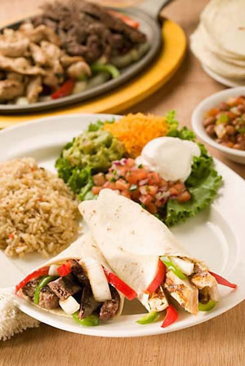

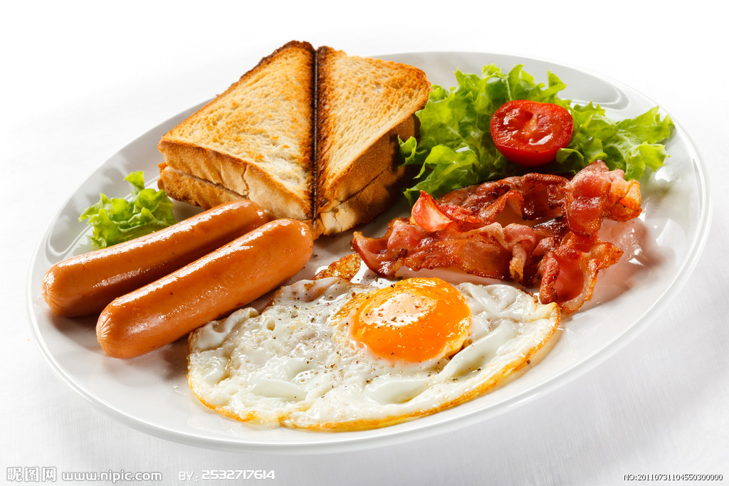
PICTURE SHOW
We’re here to connect people to higher education in the UK. We’re a people-focused business and everything we do is designed to help applicants reach their potential. It’s a great feeling.
.

Slide 9
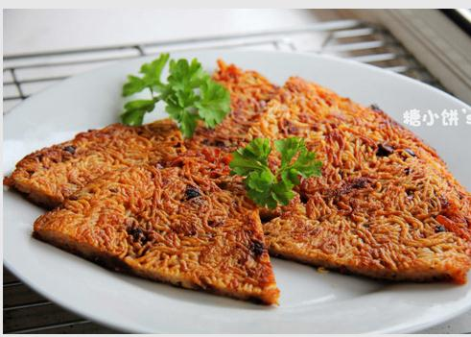
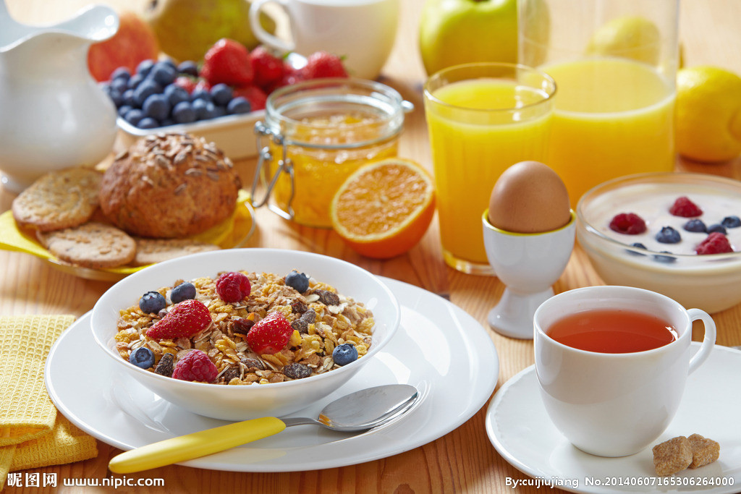
PICTURE SHOW
We’re here to connect people to higher education in the UK. We’re a people-focused business and everything we do is designed to help applicants reach their potential. It’s a great feeling.
REMARK
We’re here to connect people to higher education in the UK. We’re a people-focused business and everything we do is designed to help applicants reach their potential. It’s a great feeling.
.

Slide 10
02
教学策略与教学建议
.

Slide 11
Enter your main title
We’re here to connect people to higher education in the UK. We’re a people-focused business and everything we do is designed to help applicants reach their potential. It’s a great feeling.
We’re here to connect people to higher education in the UK. We’re a people-focused business and everything we do is designed to help applicants reach their potential. It’s a great feeling.
Enter your subtitle
Enter your subtitle
Enter your subtitle
Enter your subtitle
Enter your subtitle
We’re here to connect people to higher education in the UK. We’re a people-focused business and everything we do is designed to help applicants reach their potential. It’s a great feeling.
We’re here to connect people to higher education in the UK. We’re a people-focused business and everything we do is designed to help applicants reach their potential. It’s a great feeling.
We’re here to connect people to higher education in the UK. We’re a people-focused business and everything we do is designed to help applicants reach their potential. It’s a great feeling.
.

Slide 12



Enter your main title
Enter your subtitle
Enter your subtitle
Enter your subtitle
We’re here to connect people to higher education in the UK. We’re a people-focused business and everything we do is designed to help applicants reach their potential. It’s a great feeling.
We’re here to connect people to higher education in the UK. We’re a people-focused business and everything we do is designed to help applicants reach their potential. It’s a great feeling.
We’re here to connect people to higher education in the UK. We’re a people-focused business and everything we do is designed to help applicants reach their potential. It’s a great feeling.
.

Slide 13
Enter your main title
Enter your subtitle
01
We’re here to connect people to higher education in the UK. We’re a people-focused business and everything we do is designed to help applicants reach their potential. It’s a great feeling.
Enter your subtitle
02
We’re here to connect people to higher education in the UK. We’re a people-focused business and everything we do is designed to help applicants reach their potential. It’s a great feeling.
04
Enter your subtitle
03
03
We’re here to connect people to higher education in the UK. We’re a people-focused business and everything we do is designed to help applicants reach their potential. It’s a great feeling.
02
01
04
We’re here to connect people to higher education in the UK. We’re a people-focused business and everything we do is designed to help applicants reach their potential. It’s a great feeling.
Enter your subtitle
.

Slide 14
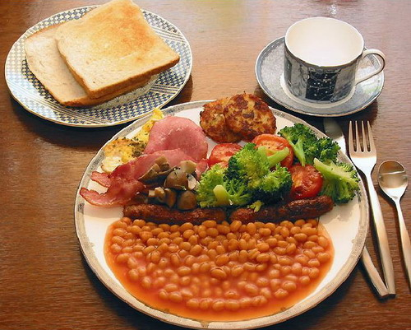
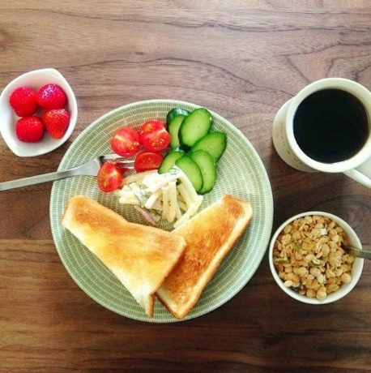
Enter your main title
We’re here to connect people to higher education in the UK. We’re a people-focused business and everything we do is designed to help applicants reach their potential. It’s a great feeling.
There is one kind of job though, that is both indispensable and difficult – perhaps impossible – to automate: the kind that requires emotional skills.
There is one kind of job though, that is both indispensable and difficult – perhaps impossible – to automate: the kind that requires emotional skills.
Enter your subtitle
Enter your subtitle
Enter your subtitle
Enter your subtitle
Enter your subtitle
There is one kind of job though, that is both indispensable and difficult – perhaps impossible – to automate: the kind that requires emotional skills.
Enter your subtitle
Enter your subtitle
There is one kind of job though, that is both indispensable and difficult – perhaps impossible – to automate: the kind that requires emotional skills.
We’re here to connect people to higher education in the UK. We’re a people-focused business and everything we do is designed to help applicants reach their potential. It’s a great feeling.
.

Slide 15
Enter your main title
We’re here to connect people to higher education in the UK. We’re a people-focused business and everything we do is designed to help applicants reach their potential. It’s a great feeling.
Enter your subtitle
We’re here to connect people to higher education in the UK. We’re a people-focused business and everything we do is designed to help applicants reach their potential. It’s a great feeling.
Enter your subtitle
Enter your subtitle
We’re here to connect people to higher education in the UK. We’re a people-focused business and everything we do is designed to help applicants reach their potential. It’s a great feeling.
.

Slide 16
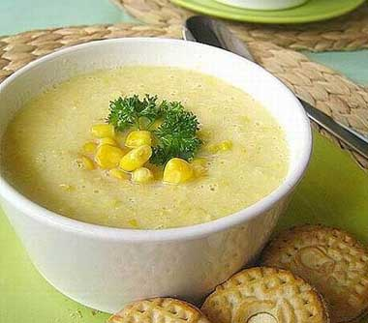
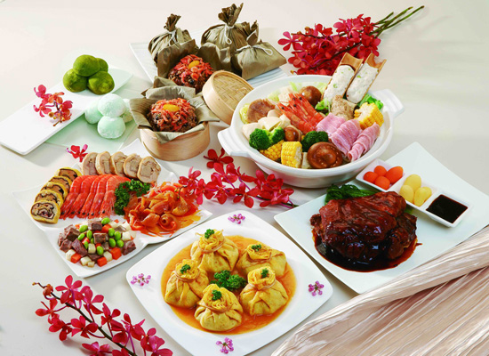
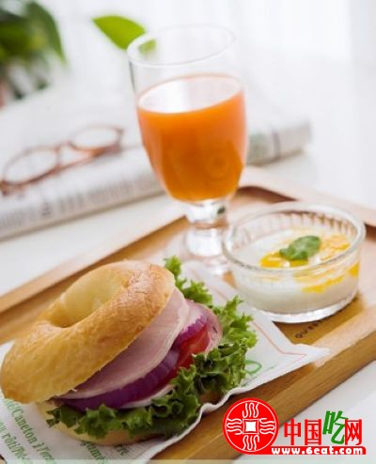
Enter your main title
Enter your subtitle
Enter your subtitle
Enter your subtitle
Enter your subtitle
We’re here to connect people to higher education in the UK. We’re a people-focused business and everything we do is designed to help applicants reach their potential. It’s a great feeling.
.

Slide 17
Enter your main title
01
02
03
04
Enter your subtitle
Enter your subtitle
Enter your subtitle
Enter your subtitle
There is one kind of job though, that is both indispensable and difficult – perhaps impossible – to automate: the kind that requires emotional skills.
There is one kind of job though, that is both indispensable and difficult – perhaps impossible – to automate: the kind that requires emotional skills.
There is one kind of job though, that is both indispensable and difficult – perhaps impossible – to automate: the kind that requires emotional skills.
There is one kind of job though, that is both indispensable and difficult – perhaps impossible – to automate: the kind that requires emotional skills.
.

Slide 18
03
人类食物的营养成分
.

Slide 19
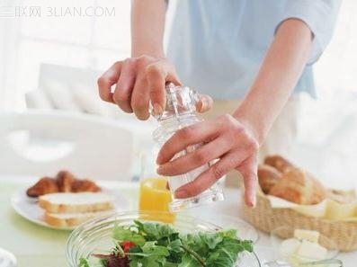
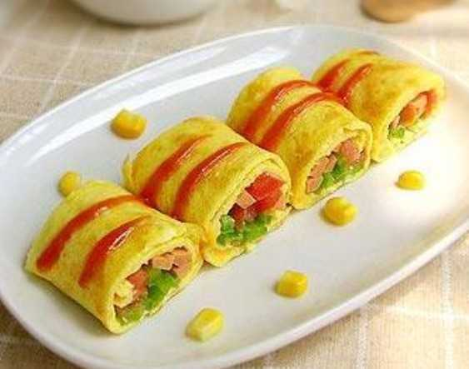
We’re here to connect people to higher education in the UK. We’re a people-focused business and everything we do is designed to help applicants reach their potential. It’s a great feeling.
We’re here to connect people to higher education in the UK. We’re a people-focused business and everything we do is designed to help applicants reach their potential. It’s a great feeling.
PICTURE SHOW
We’re here to connect people to higher education in the UK. We’re a people-focused business and everything we do is designed to help applicants reach their potential. It’s a great feeling.
.

Slide 20


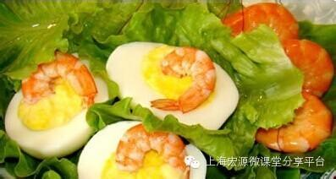
PICTURE SHOW
We’re here to connect people to higher education in the UK. We’re a people-focused business and everything we do is designed to help applicants reach their potential. It’s a great feeling.
.

Slide 21

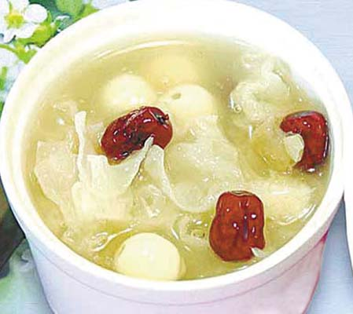
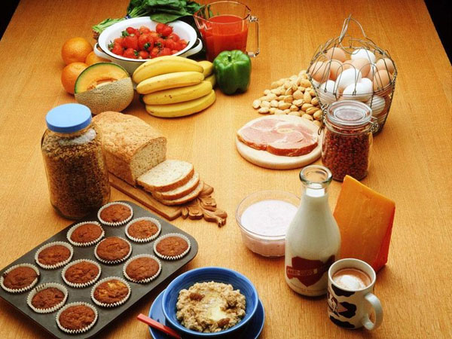


We’re here to connect people to higher education in the UK. We’re a people-focused business and everything we do is designed to help applicants reach their potential. It’s a great feeling.
PICTURE SHOW
.

Slide 22
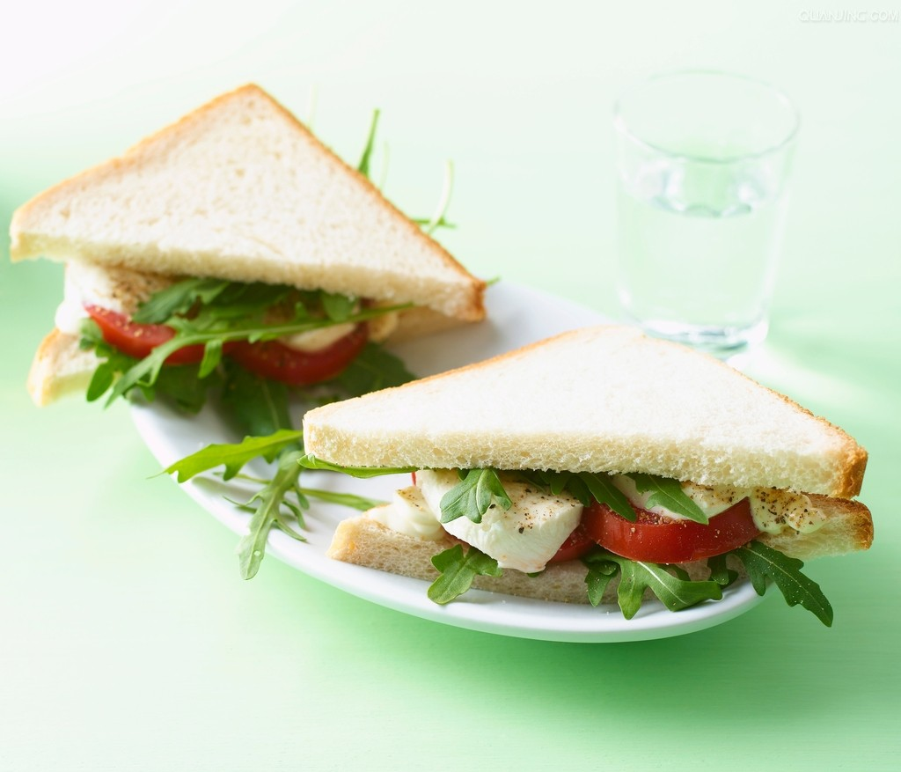

We’re here to connect people to higher education in the UK. We’re a people-focused business and everything we do is designed to help applicants reach their potential. It’s a great feeling.
PICTURE SHOW
PICTURE SHOW
.

Slide 23
Enter your main title
Enter your subtitle
Enter your subtitle
01
We’re here to connect people to higher education in the UK. We’re a people-focused business and everything we do is designed to help applicants reach their potential. It’s a great feeling.
02
We’re here to connect people to higher education in the UK. We’re a people-focused business and everything we do is designed to help applicants reach their potential. It’s a great feeling.
We’re here to connect people to higher education in the UK. We’re a people-focused business and everything we do is designed to help applicants reach their potential. It’s a great feeling.
We’re here to connect people to higher education in the UK. We’re a people-focused business and everything we do is designed to help applicants reach their potential. It’s a great feeling.
.

Slide 24

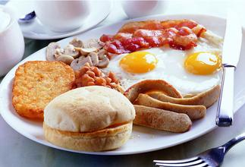
Enter your main title
There is one kind of job though, that is both indispensable and difficult – perhaps impossible – to automate: the kind that requires emotional skills.
There is one kind of job though, that is both indispensable and difficult – perhaps impossible – to automate: the kind that requires emotional skills.
There is one kind of job though, that is both indispensable and difficult – perhaps impossible – to automate: the kind that requires emotional skills.
Enter your subtitle
Enter your subtitle
Enter your subtitle
.

Slide 25
Enter your main title
4
1
There is one kind of job though, that is both indispensable and difficult – perhaps impossible – to automate: the kind that requires emotional skills.
3
Enter your subtitle
Enter your subtitle
2
Enter your subtitle
There is one kind of job though, that is both indispensable and difficult – perhaps impossible – to automate: the kind that requires emotional skills.
There is one kind of job though, that is both indispensable and difficult – perhaps impossible – to automate: the kind that requires emotional skills.
Enter your subtitle
There is one kind of job though, that is both indispensable and difficult – perhaps impossible – to automate: the kind that requires emotional skills.
.

Slide 26
04
人类食物的营养成分
.

Slide 27
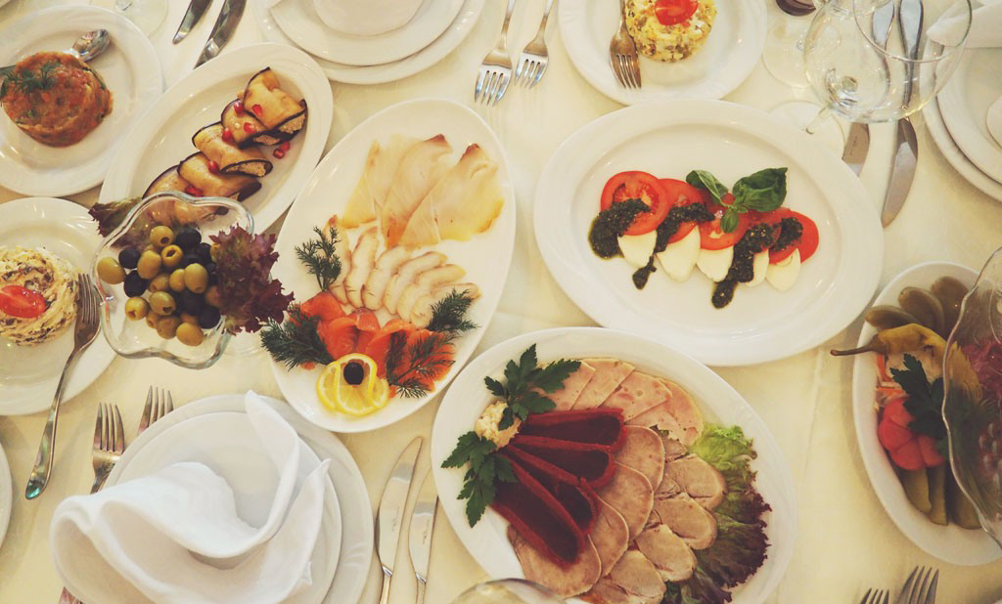
Enter your main title
Enter your subtitle
There is one kind of job though, that is both indispensable and difficult – perhaps impossible – to automate: the kind that requires emotional skills.
There is one kind of job though, that is both indispensable and difficult – perhaps impossible – to automate: the kind that requires emotional skills.
Enter your subtitle
There is one kind of job though, that is both indispensable and difficult – perhaps impossible – to automate: the kind that requires emotional skills.
.

Slide 28
Enter your main title
Enter your subtitle
There is one kind of job though, that is both indispensable and difficult – perhaps impossible – to automate: the kind that requires emotional skills.
Enter your subtitle
There is one kind of job though, that is both indispensable and difficult – perhaps impossible – to automate: the kind that requires emotional skills.
Enter your subtitle
There is one kind of job though, that is both indispensable and difficult – perhaps impossible – to automate: the kind that requires emotional skills.
Enter your subtitle
There is one kind of job though, that is both indispensable and difficult – perhaps impossible – to automate: the kind that requires emotional skills.
.

Slide 29
Enter your main title
Enter your subtitle
Enter your subtitle
02
There is one kind of job though, that is both indispensable and difficult – perhaps impossible – to automate: the kind that requires emotional skills.
There is one kind of job though, that is both indispensable and difficult – perhaps impossible – to automate: the kind that requires emotional skills.
01
Enter your
subtitle
03
Enter your subtitle
04
Enter your subtitle
There is one kind of job though, that is both indispensable and difficult – perhaps impossible – to automate: the kind that requires emotional skills.
There is one kind of job though, that is both indispensable and difficult – perhaps impossible – to automate: the kind that requires emotional skills.
.

Slide 30
Enter your main title
Enter your subtitle
Enter your subtitle
Enter your subtitle
Enter your subtitle
There is one kind of job though, that is both indispensable and difficult – perhaps impossible – to automate: the kind that requires emotional skills.
There is one kind of job though, that is both indispensable and difficult – perhaps impossible – to automate: the kind that requires emotional skills.
There is one kind of job though, that is both indispensable and difficult – perhaps impossible – to automate: the kind that requires emotional skills.
There is one kind of job though, that is both indispensable and difficult – perhaps impossible – to automate: the kind that requires emotional skills.
30%
50%
70%
80%
.

Slide 31
添加标题内容
Enter your main title
Enter your subtitle
Enter your subtitle
Enter your subtitle
There is one kind of job though, that is both indispensable and difficult – perhaps impossible – to automate: the kind that requires emotional skills.
There is one kind of job though, that is both indispensable and difficult – perhaps impossible – to automate: the kind that requires emotional skills.
There is one kind of job though, that is both indispensable and difficult – perhaps impossible – to automate: the kind that requires emotional skills.
Enter your subtitle
Enter your subtitle
Enter your subtitle
There is one kind of job though, that is both indispensable and difficult – perhaps impossible – to automate: the kind that requires emotional skills.
There is one kind of job though, that is both indispensable and difficult – perhaps impossible – to automate: the kind that requires emotional skills.
There is one kind of job though, that is both indispensable and difficult – perhaps impossible – to automate: the kind that requires emotional skills.
.

Slide 32
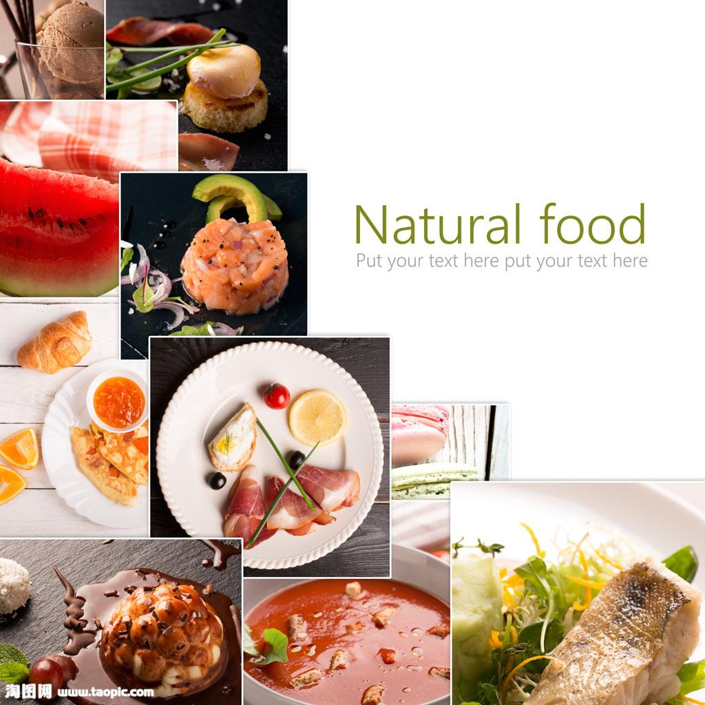

Enter your main title
Enter your subtitle
1
There is one kind of job though, that is both indispensable and difficult – perhaps impossible – to automate: the kind that requires emotional skills.
Enter your subtitle
1
There is one kind of job though, that is both indispensable and difficult – perhaps impossible – to automate: the kind that requires emotional skills.
Enter your subtitle
1
There is one kind of job though, that is both indispensable and difficult – perhaps impossible – to automate: the kind that requires emotional skills.
.

Slide 33



Enter your main title
Enter your subtitle
Enter your subtitle
Enter your subtitle
There is one kind of job though, that is both indispensable and difficult – perhaps impossible – to automate: the kind that requires emotional skills.
There is one kind of job though, that is both indispensable and difficult – perhaps impossible – to automate: the kind that requires emotional skills.
There is one kind of job though, that is both indispensable and difficult – perhaps impossible – to automate: the kind that requires emotional skills.
.

Slide 34


Enter your main title
Enter your subtitle
We’re here to connect people to higher education in the UK. We’re a people-focused business and everything we do is designed to help applicants reach their potential. It’s a great feeling.
Enter your subtitle
Enter your subtitle
Enter your subtitle
There is one kind of job though, that is both indispensable and difficult – perhaps impossible – to automate: the kind that requires emotional skills.
There is one kind of job though, that is both indispensable and difficult – perhaps impossible – to automate: the kind that requires emotional skills.
We’re here to connect people to higher education in the UK. We’re a people-focused business and everything we do is designed to help applicants reach their potential. It’s a great feeling.
.

Slide 35
Enter your main title
Enter your subtitle
Enter your subtitle
There is one kind of job though, that is both indispensable and difficult – perhaps impossible – to automate: the kind that requires emotional skills.
There is one kind of job though, that is both indispensable and difficult – perhaps impossible – to automate: the kind that requires emotional skills.
04
02
03
01
Enter your subtitle
Enter your subtitle
There is one kind of job though, that is both indispensable and difficult – perhaps impossible – to automate: the kind that requires emotional skills.
There is one kind of job though, that is both indispensable and difficult – perhaps impossible – to automate: the kind that requires emotional skills.
.

Slide 36
Enter your main title
Enter your subtitle
Enter your subtitle
There is one kind of job though, that is both indispensable and difficult – perhaps impossible – to automate: the kind that requires emotional skills.
There is one kind of job though, that is both indispensable and difficult – perhaps impossible – to automate: the kind that requires emotional skills.
Enter your subtitle
Enter your subtitle
There is one kind of job though, that is both indispensable and difficult – perhaps impossible – to automate: the kind that requires emotional skills.
There is one kind of job though, that is both indispensable and difficult – perhaps impossible – to automate: the kind that requires emotional skills.
.

Slide 37

THANKS
-- 人 类 的 食 物 --
.

