Slide 1


儿童成长教育通用教学课件
GENERAL COURSEWARE FOR CHILDREN'S GROWTH EDUCATION
情缘素材

Slide 2

目录
01
添加您的主标题
02
添加您的主标题
03
添加您的主标题
04
添加您的主标题

Slide 3
01
添加您的主标题
This PPT template for the rice husk designer pencil demo works, focusing on the production of high-end design husk designer pencil demo works, focusing on the production of high-end design This PPT template for the

Slide 4
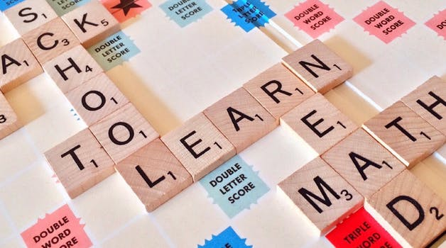


添加您的主标题
儿童教育
This PPT template for the rice husk designer pencil demo works, focusing on the production of high-end design husk designer pencil demo works, focusing
儿童教育
This PPT template for the rice husk designer pencil demo works, focusing on the production of high-end design husk designer pencil demo works, focusing

Slide 5
添加您的主标题
2014
2017
2015
2016
儿童教育
儿童教育
This PPT template for the rice husk designer pencil demo works, focusing on the production of
This PPT template for the rice husk designer pencil demo works, focusing on the production of
儿童教育
儿童教育
This PPT template for the rice husk designer pencil demo works, focusing on the production of
This PPT template for the rice husk designer pencil demo works, focusing on the production of

Slide 6
添加您的主标题
儿童教育
儿童教育
儿童教育
儿童教育
This PPT template for the rice husk designer pencil demo works, focusing on the
This PPT template for the rice husk designer pencil demo works, focusing on the
This PPT template for the rice husk designer pencil demo works, focusing on the
This PPT template for the rice husk designer pencil demo works, focusing on the

Slide 7
02
添加您的主标题
This PPT template for the rice husk designer pencil demo works, focusing on the production of high-end design husk designer pencil demo works, focusing on the production of high-end design This PPT template for the

Slide 8
添加您的主标题
儿童教育
儿童教育
2014
2016
This PPT template for the rice husk designer pencil demo works, focusing on the production of
This PPT template for the rice husk designer pencil demo works, focusing on the production of
儿童教育
2015
儿童教育
2017
This PPT template for the rice husk designer pencil demo works, focusing on the production of
This PPT template for the rice husk designer pencil demo works, focusing on the production of

Slide 9
添加您的主标题
01
This PPT template for the rice husk designer pencil demo works, focusing on the production of
02
This PPT template for the rice husk designer pencil demo works, focusing on the production of
03
This PPT template for the rice husk designer pencil demo works, focusing on the production of
04
This PPT template for the rice husk designer pencil demo works, focusing on the production of

Slide 10
添加您的主标题
儿童教育
S
W
儿童教育
This PPT template for the rice husk designer pencil demo
This PPT template for the rice husk designer pencil demo
儿童教育
O
T
儿童教育
This PPT template for the rice husk designer pencil demo
This PPT template for the rice husk designer pencil demo

Slide 11
03
添加您的主标题
This PPT template for the rice husk designer pencil demo works, focusing on the production of high-end design husk designer pencil demo works, focusing on the production of high-end design This PPT template for the

Slide 12
添加您的主标题
1
This PPT template for the rice husk designer pencil demo works, focusing on the production of
2
This PPT template for the rice husk designer pencil demo works, focusing on the production of
3
This PPT template for the rice husk designer pencil demo works, focusing on the production of
4
This PPT template for the rice husk designer pencil demo works, focusing on the production of

Slide 13

添加您的主标题
2014
2015
2016
2017
儿童教育
儿童教育
儿童教育
儿童教育
This PPT template for the rice husk designer pencil demo works, focusing on the production of
This PPT template for the rice husk designer pencil demo works, focusing on the production of
This PPT template for the rice husk designer pencil demo works, focusing on the production of
This PPT template for the rice husk designer pencil demo works, focusing on the production of

Slide 14

添加您的主标题
儿童教育
This PPT template for the rice husk designer pencil demo works, focusing on the

Slide 15
04
添加您的主标题
This PPT template for the rice husk designer pencil demo works, focusing on the production of high-end design husk designer pencil demo works, focusing on the production of high-end design This PPT template for the

Slide 16
添加您的主标题
儿童教育
儿童教育
This PPT template for the rice husk designer pencil demo
This PPT template for the rice husk designer pencil demo
儿童教育
儿童教育
This PPT template for the rice husk designer pencil demo
This PPT template for the rice husk designer pencil demo

Slide 17
添加您的主标题
儿童教育
儿童教育
This PPT template for the rice husk designer pencil demo works, focusing on the production of
This PPT template for the rice husk designer pencil demo works, focusing on the production of

Slide 18
感谢同学们的积极参与
GENERAL COURSEWARE FOR CHILDREN'S GROWTH EDUCATION
情缘素材
Notes:
更多模板请关注：https://haosc.taobao.com

